Slide 1

Software Test Automation Group (STAG)
Screenplay design pattern
By Matthew Chan

Slide 2
Agenda
Introduction
Layers of abstraction
Screenplay pattern
TODOMVC example
Report
Questions

Slide 3
Serenity-BDD
An open source library whose goal is to make your automation test suite a living documentation
Also a full fledged automation framework
Supports BDD through the utilization of a “Serenity step library”
Wrapper on top of Selenium WebDriver/REST-API library
Integrates with BDD/Unit test frameworks
Supports the page object design pattern and the screenplay design pattern

Slide 4
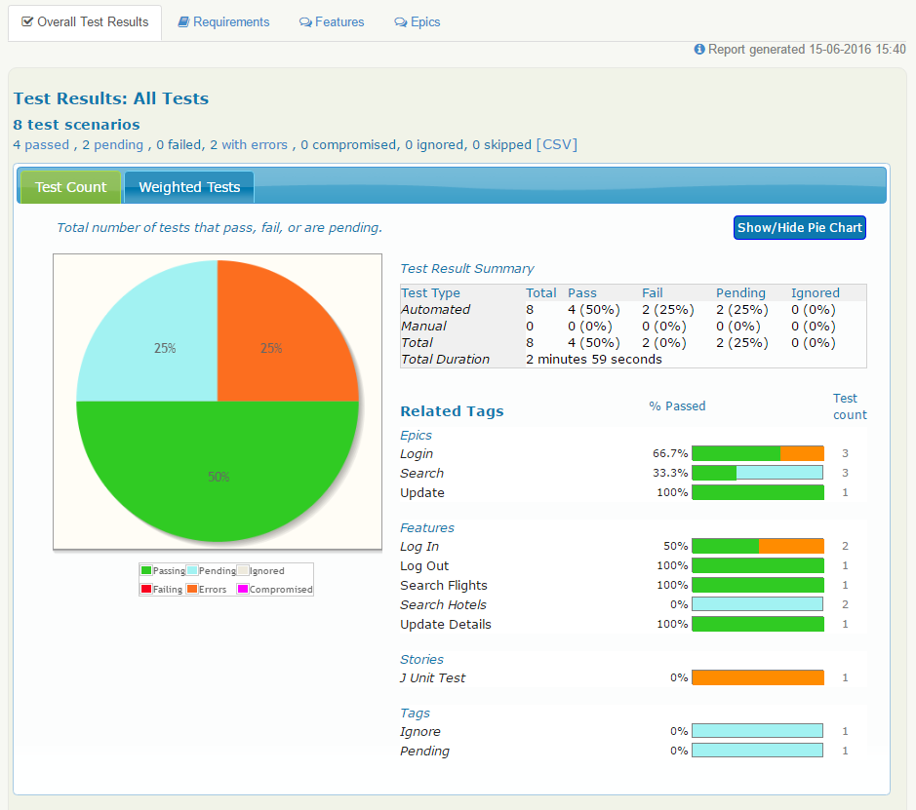
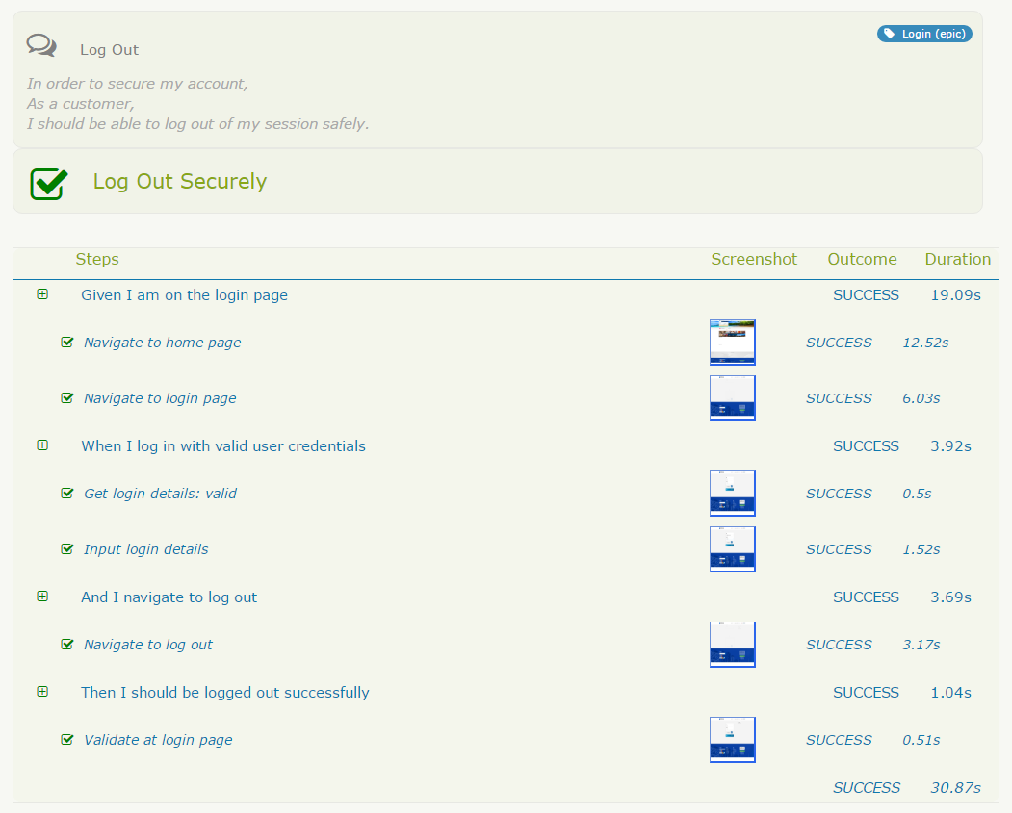
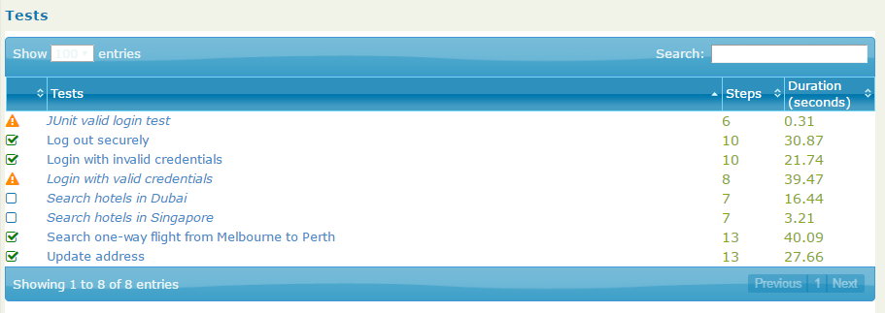
Serenity HTML Report

Slide 5
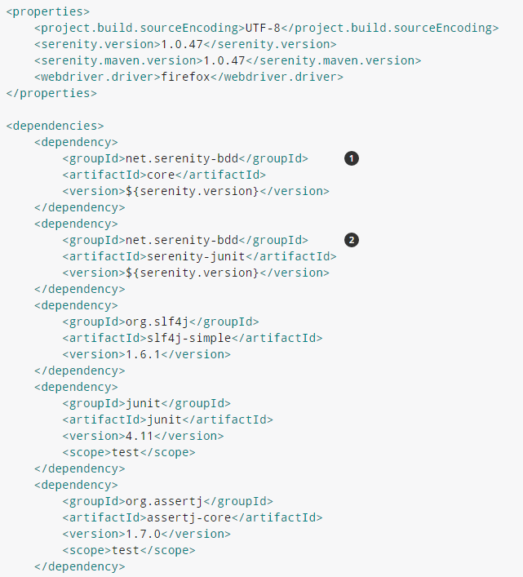
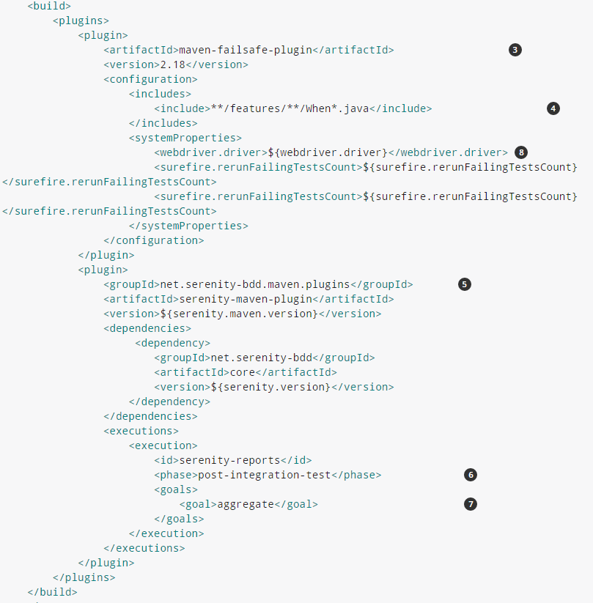
Getting started
JAVA build tools
Maven
Ant
Gradle
We used maven in our demo:
Core Serenity dependency
JUnit Serenity dependency
The Maven Failsafe plugin
Include only tests in the junit directory
The Serenity Maven Plugin
Generate the aggregate reports during the post-integration test phase
Call the aggregate goal to generate them
Pass the webdriver.driver system property to the tests.

Slide 6
Serenity Step Library
Use multiple layers of abstraction to hide the complexity
Layer in between test and page objects
Separate the “what” from the “how”
Methods with the @Step annotation are recognized as a step library method
Step library classes are automatically instantiated with the use of the @Steps annotation
Adds additional reporting steps to the HTML report

Slide 7
Context Manager / Dependency Injection
Built in context manager to share state between classes
Useful if you use BDD frameworks such as Cucumber to share a member from one step-def to another.
Serenity.getCurrentSession().get(“key”);
Serenity.setSessionVariable(“key”).to(“value”);
No need to manually instantiate step library classes, Serenity does it for you automatically.
From the step library classes, it will also automatically instantiate your page objects for you, however your page objects will need to have a constructor that accepts the WebDriver parameter.

Slide 8
Serenity with Junit / Cucumber
//Given
navSS.openHomePage();
navSS.navigateToLoginPage();
//When
loginSS.getLoginDetails("valid");
loginSS.inputLoginDetails();
//Then
loginSS.validateLoggedIn();
navSS.validateAtMyAccountPage();
Scenario: Login with valid credentials
Given I am on the login page
When I log in with valid user credentials
Then I should be logged in successfully

Slide 9
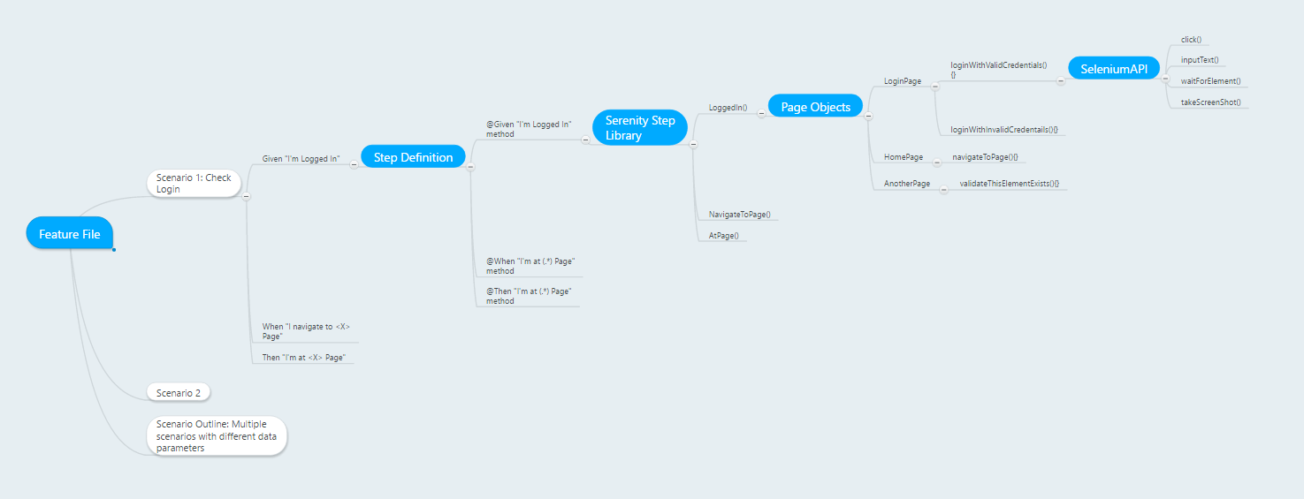
Serenity with Cucumber Demo

Slide 10
Serenity Features
PageObject
WebElementFacade
REST-Assured integration
JIRA Integration
Saucelabs integration
Easy parallel execution

Slide 11
Extent Reports
Supports both JAVA & C#
Simple report library – highly customizable
Creates HTML report displaying multiple tabs
Tests
Categories / Features
Graphs
Defects/Logs
http://relevantcodes.com/Tools/ExtentReports2/ExtentJava.html
http://extentx.herokuapp.com/#/

Slide 12
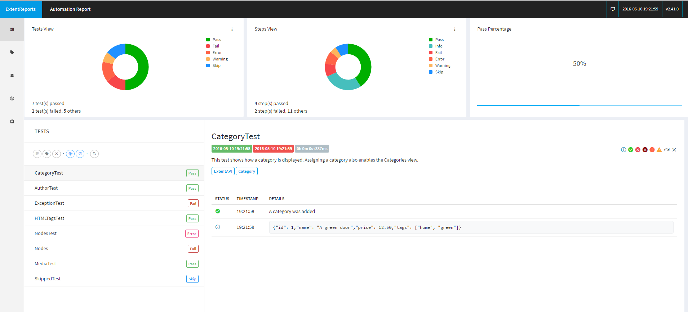
ExtentReports HTML Report

Slide 13
Basic Usage
Initialize report
ExtentReports(String filePath, Boolean replaceExisting=true/false, DisplayOrder displayOrder, NetworkMode networkMode, Locale locale)
Start/End Test
ExtentReports extent = new ExtentReports(file-path, replaceExisting);
ExtentTest test = extent.startTest("Test Name", "Sample description");
test.log(LogStatus.PASS, "Step details");
extent.endTest(test);
extent.flush();
Assign Categories / Children / Author
Insert Custom HTML
Insert Snapshots / Screencasts
ExtentX – Reports server

Slide 14
Allure-Framework
Support for a wide variety of languages
Two steps
Runs test to gather information and generate XML files
Aggregates the files and generates HTML report
Uses adapters/listeners that integrated with existing test frameworks
HTML report contains multiple tabs
Overview
Defects
xUnit
Behaviours
Graph
Timeline
http://ci.qatools.ru/job/allure-core_master-deploy/lastSuccessfulBuild/Allure_report/

Slide 15
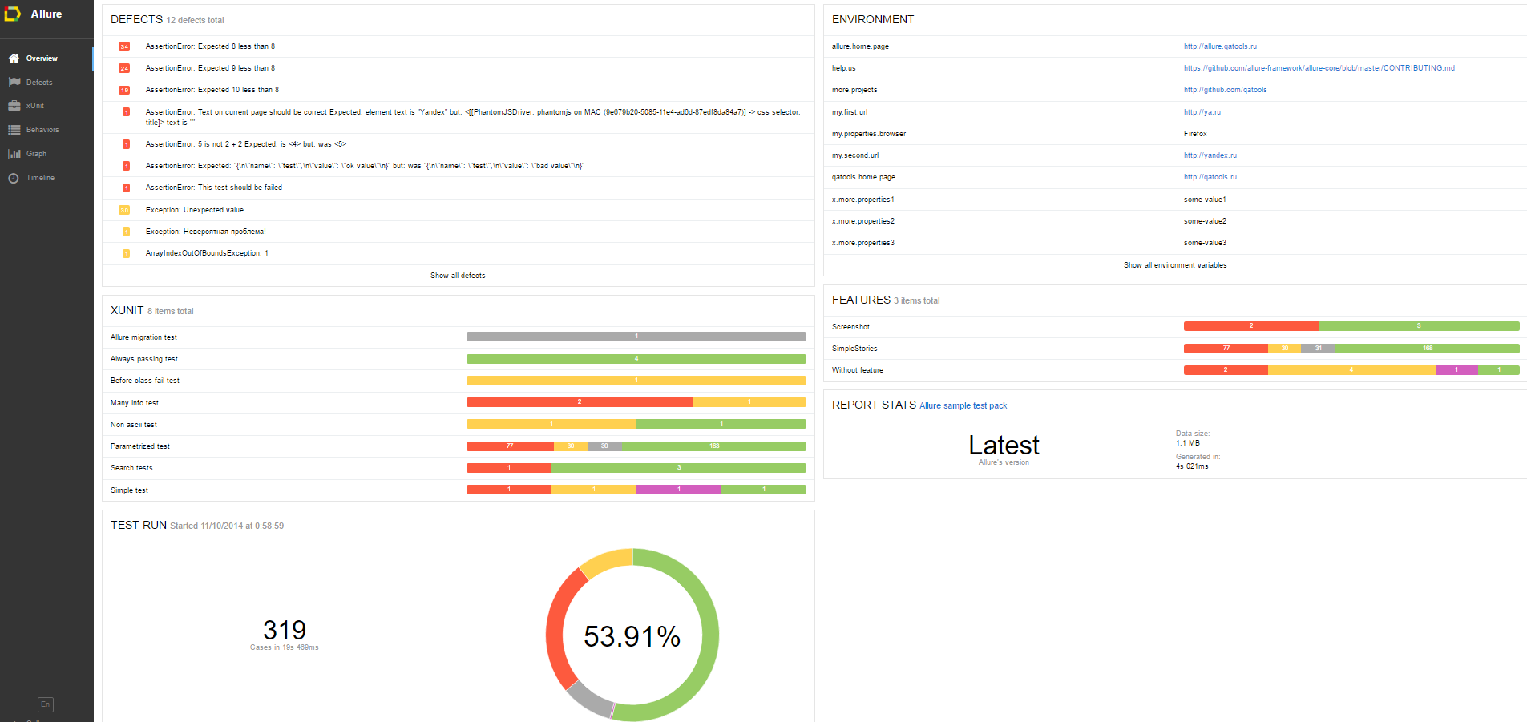
Allure-Framework HTML Report

Slide 16

Questions?

Slide 17
Appendix
Serenity-BDD
http://thucydides.info/docs/serenity-staging/
Extent-Reports
http://extentreports.relevantcodes.com/
Allure-Framework
http://allure.qatools.ru/

